Slide 1

Frito-Lay Attrition Study
DDSAnalystic
Consultant: Katon Pang
Notes:
Hello. My name is Katon Pang, data scientist with DDS Analytic.
We were asked to work with talent management to identify factors that lead to attrition in Frito Lay, and we’re here presenting our findings.
We Thank you very much for this opportunity and your time joining this presentation today.

Slide 2


The Study
Obtain, review and analyze existing employee data
Identify top trends in attrition
Job role specific trends
Model building and prediction
Notes:
Minimizing employee turnover is instrumental in cost reduction and strategic workforce planning. Furthermore, it enables Frito Lay to attain higher productivity levels, enhances customer satisfaction, and be more attractive to top-tier talent.
This study is to identify top factors that lead to attrition, to derive a model to predict attritions and a model to predict monthly income, and to discover any job role specific trends.

Slide 3
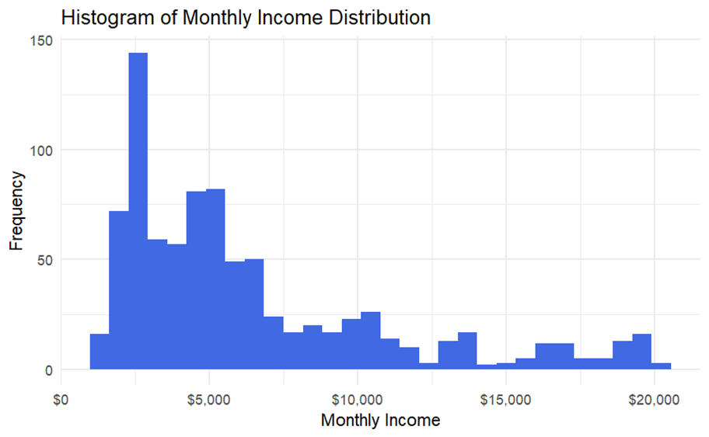
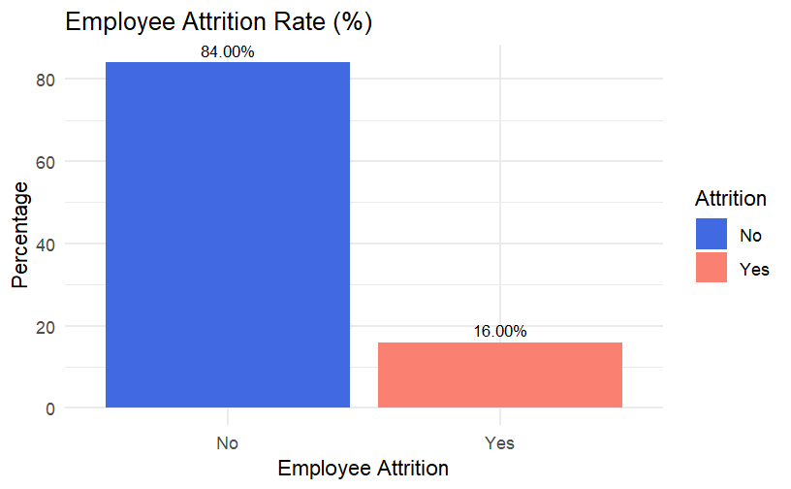
Dataset
870 Employees
31 Attributes
17 Categorical, 8 non-numeric
14 Continuous
No missing data
Most data are right-skewed
Correlation between Attrition and other variables
Oversampling
Notes:
We were given a dataset of 870 employees. After removing employee identification information, there were 31 attributes, 8 of them were non-numeric categorical variables. There was no missing values in the dataset.
Most attributes in our data were heavily right-skewed, as illustrated here by the monthly income distribution, often we looked at the medians of the attribute for the center value.
The attributes were first passed through a process to find their correlation with Attrition. The 8 non-numeric variables were converted to their numeric representation before the process.
Then we further analyzed those relationships with relatively higher correlation and also other interesting factors.
As shown on this bar plot, there’s 16% attrition rate, or 140 employees who left the company. The dataset is imbalanced as expected since attrition is not a very frequent event.
We will use oversampling method to remediate the imbalance when we train and validate our attrition models. we’ll go into the details later.

Slide 4
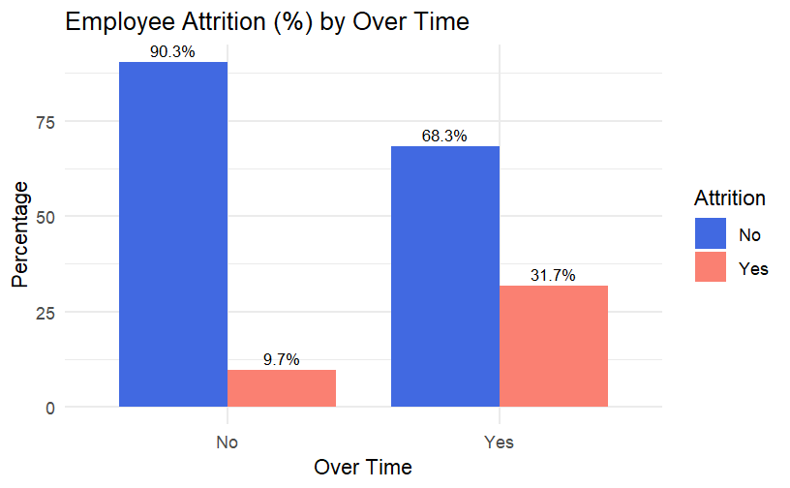
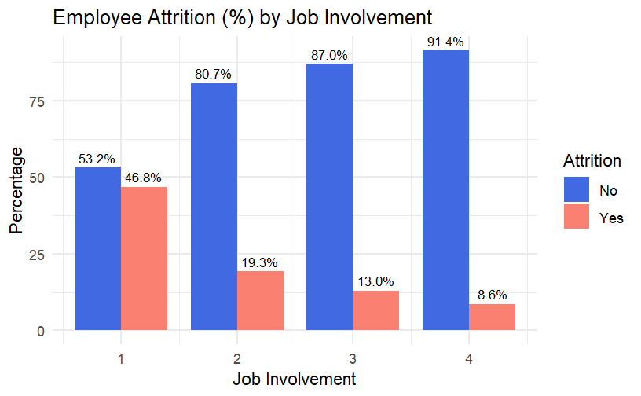
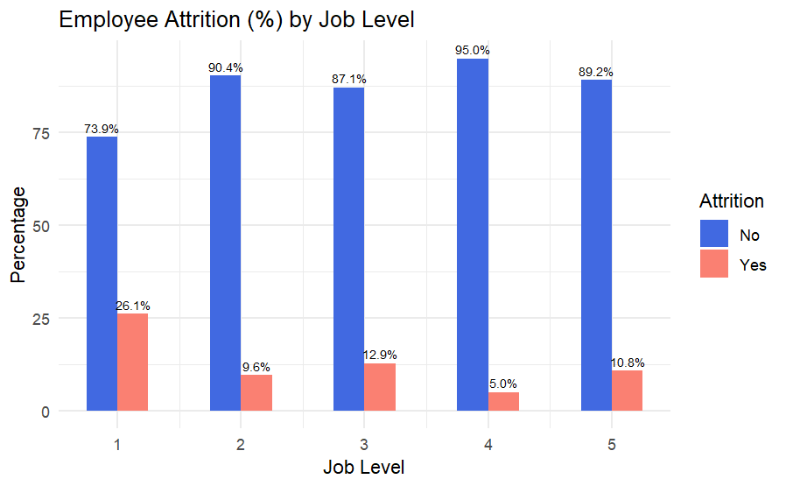
Top Contributing Factors
Notes:
Let’s take a look at the top 3 contributing factors to employee attrition.
As shown on the barplot on the left, attrition by job involvement. Almost half of the employees who were most dissatisfied with their involvement left the company.
47% of those who left the company rated their job involvement level 1 and 2.
Looking at the barplot on the right, attrition by overtime.
We can see the big difference in attrition rate between employees who worked overtime vs those didn’t work overtime
57% of those who left the company had worked overtime.
Barplot at the center shows attrition by job level. Employees at job level 1 were more likely to leave the company comparing to others.
61% of those who left the company were Job level 1
Job level is higherly correlated with monthly income and total working years. Hence salary is part of the top 3 contributing factors. Work experience is top indicator
Therefore, we assume that, employees who are relatively younger, at entry-level or job level 1, are single, at stock option level 0 or those who do not own any company stock, those who work overtime, have low job involvement, would be more likely to leave the company.

Slide 5
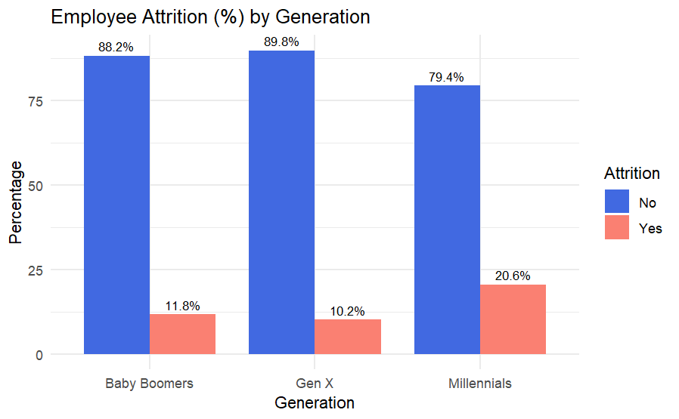
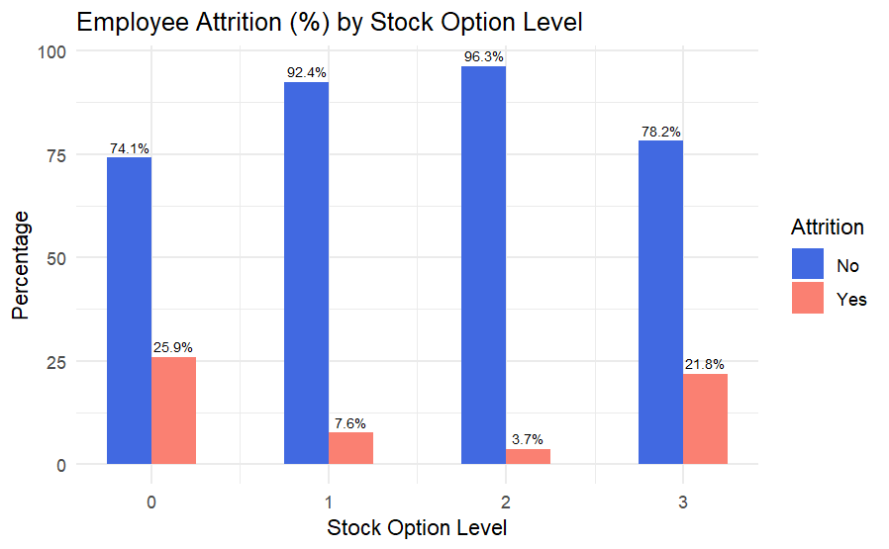
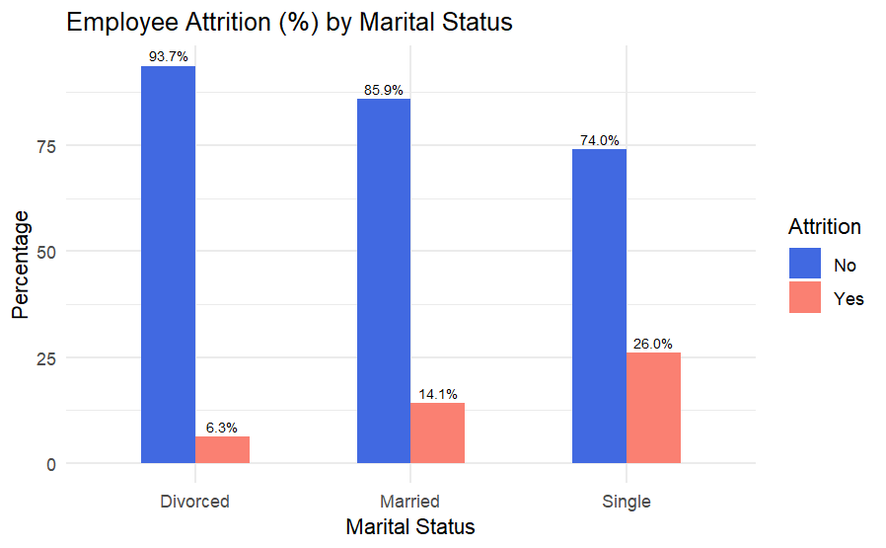
Top Indicators
Notes:
Here we have the top 3 indicators for employee attrition.
Barplot on the left, attrition by stock option level.
We can see the attrition rate of stock option level 0 is higher than the others.
70% of those who left the company were at level 0.
we assumed level 0 means they does not own any company stocks, that they didn’t financially invest in the company. Or they didn’t have expendable income to invest.
Looking at the barplot on the right, shows attrition by generation or age. Milliennals had a higher attrition rate.
70% of those left the company were Millennials. The group represented 36 years-old or younger at the time of this data gathered.
The Bar graph at the center shows attrition by Marital Status. Singles had a highest attrition rate.
50% of those who left were single.
Therefore, we assume that, employees who are relatively younger, at entry-level or job level 1, are single, at stock option level 0 or those who do not own any company stock, those who work overtime, have low job involvement, would be more likely to leave the company.

Slide 6
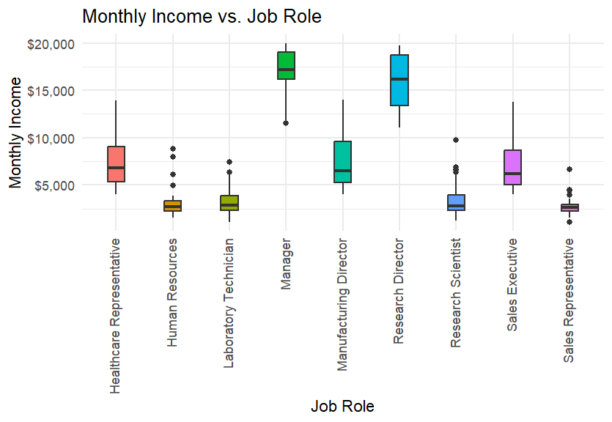
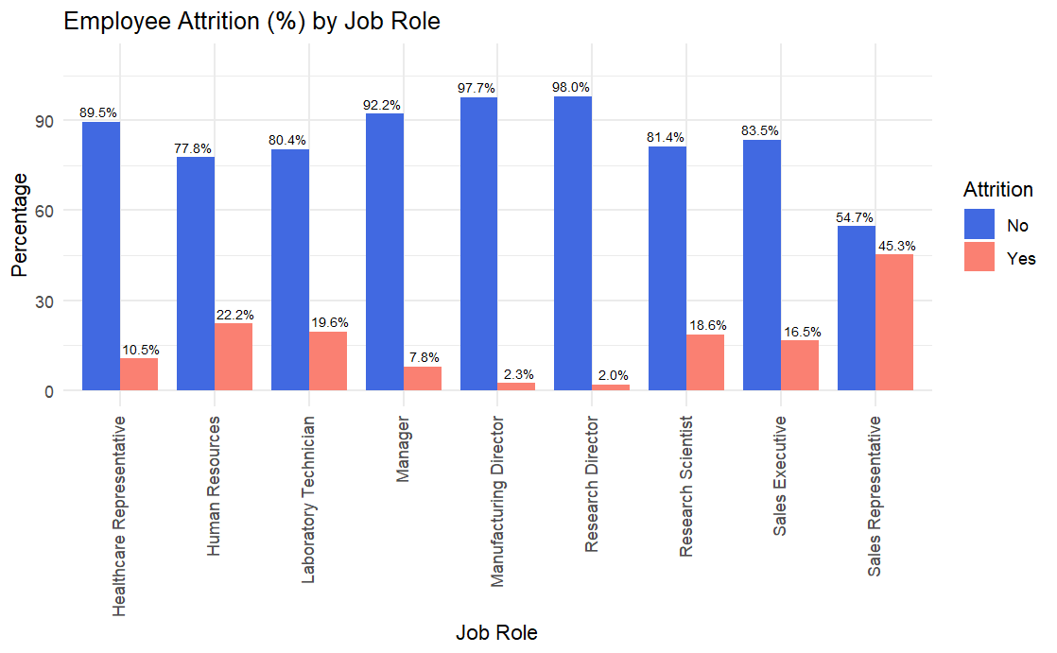
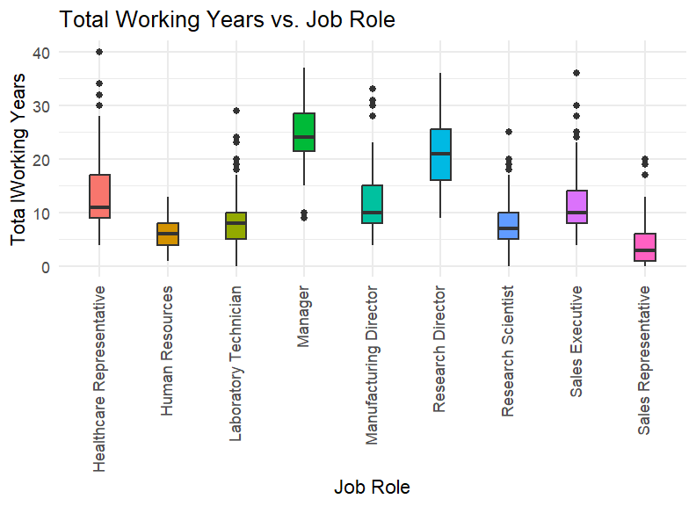
Job Role Trends
Notes:
For job role related trends, first we looked at attrition and monthly income by job role, and then other factors.
As you can see here, Sales Representative had the highest attrition rate among other job roles, and the lowest in term of median monthly income and median total working years.
Manager and Research Director are the top 2 on median monthly income as well as median total working years, also among the lowest in attrition rate by job role.
The median monthly income of all the employees in the dataset is about $5000.
In addition to Sales Representative, Human Resources, Laboratory technician, and Research Scientist had median monthly income below $5,000, as well as having median total working years relatively lower than other job roles. They all had median job level as level 1, median of 2 years at current role. As these factors correlated to attrition, these 4 job roles had higher attrition rate compared to others. Sale representative stands out as the lowest with median 2 years at the company. All these reflected to their higher attrition rate.
Another interesting aspect is that Manufacturing Director doesn’t have as high the median monthly income as Manager and Research Director, but they are among the lowest in term of attrition rate, even lower than that of the Manager. They could be studied further there may be something that we could learn from and apply to other job roles to increase retention.
Manufacturing Directors did not have as high median monthly income, total working years, years at the company, or age as Managers and Research Directors. However, Manufacturing Directors had one of the lowest attrition rates, along with Research Directors. This group is worth further study to identify practices that led to their higher retention rate, in areas such as morale, recognition, environment, support, leadership, etc. The lessons learned may assist in increasing retention rates among Healthcare Representatives and Sales Executives, as they share similar ranges in median monthly income, total working years, years at the company, and age. Furthermore, these insights might contribute to improving the retention of other job roles throughout the company.

Slide 7
Attrition Models
Approach:
Oversampling for imbalanced dataset
70% train, 30% validate
Positive class was set to “Yes” for Attrition
Criteria: at least 60% for both sensitivity and specificity
Two algorithms: Naïve Bayes, k-Nearest Neighbors (k-NN)
Variables: Job Involvement, Overtime, Stock Option Level, Marital Status, Job Role
Model | Naïve Bayes | k-NN
Accuracy | 0.7237 | 0.7626
Sensitivity/Recall (True Positive Rate) | 0.7565 | 0.8087
Specificity (True Negative Rate) | 0.6875 | 0.7115
Precision | 0.7280 | 0.7561
F1 | 0.7420 | 0.7815
'Positive' Class | “Yes” | “Yes”
k-NN was used to predict a new dataset of 300 observations (employees)
Notes:
After visualization and analyses, we moved into building a statistical model to predict future instances of attrition.
As we mentioned earlier, we have an imbalanced dataset.
Within the dataset, the target class 'attrition,' labeled as 'Yes,' comprises only 16% due to the relatively infrequent occurrence of attrition. The challenge lies in the model learning patterns associated with this minority class. To address this challenge, we incorporate oversampling techniques during both training and validation stages, ensuring a more balanced representation and enhancing the model's ability to generalize across both classes, with a particular focus on the minority class.
The sample were split into 70% as the training set and 30% as the validation set.
For the models’ diagnostic tests, all positive class was set to “Yes” for Attrition. The criteria for passing a model is having 60% in both sensitivity and specificity.
We conducted numerous iterations of Naïve Bayes and k-Nearest Neighbors or (knn) models, experimenting with various combinations and quantities of variables.
They were evaluated based on whether they met the criteria, as well as accuracy and F1 score.
The final combination set of variables chosen are Job Involvement, Overtime, Stock Option Level, Marital Status, and Job Role.
Comparing between Naïve Bayes and k-NN models with the same variables, k-NN resulted better performance in all measures, both sensitivity and specificity are above 60%, F1 score 78%.
F1 score reflects how well the model is performing, considering both the correctness of positive predictions and the capture of all actual positives. Here in detecting attrition.
Therefore, k-NN model was chosen for performing the prediction.

Slide 8

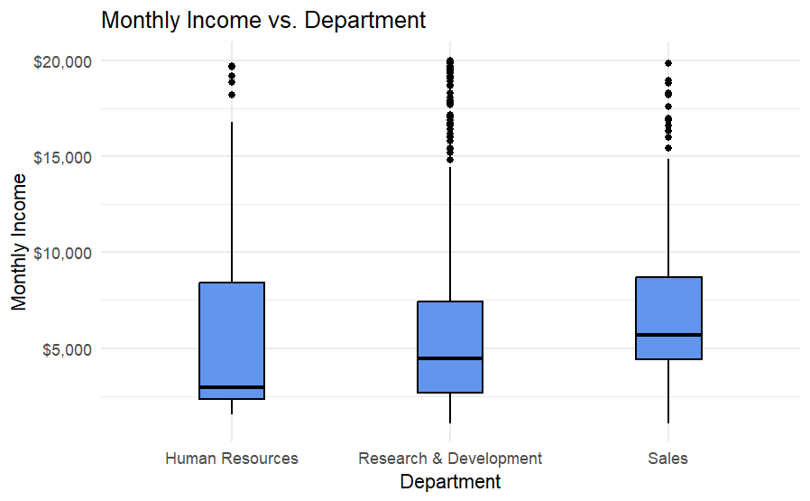
Monthly Income
Min = $1,081
1st Quartile (25%) = $2,840
Median = $4,946
Mean = $6,390
3rd Quartile (75%) = $8,182
Max = $19,999
Standard Deviation = $4,598
Notes:
We were also asked to conduct a monthly income analysis.
Monthly Income distribution are very right-skewed, with median monthly income of your workforce at around $5000.
When looking at the monthly income by department, Sales department had the highest median.

Slide 9
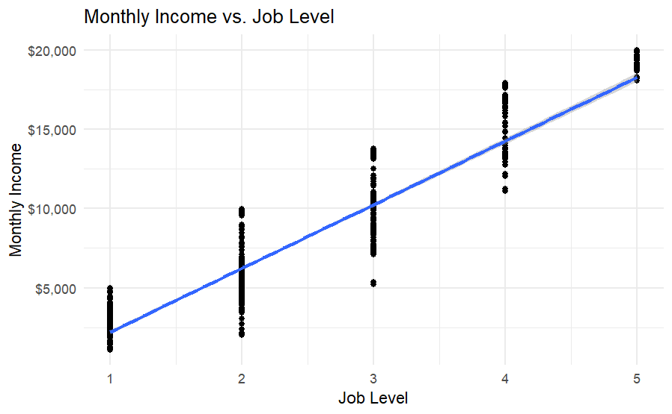
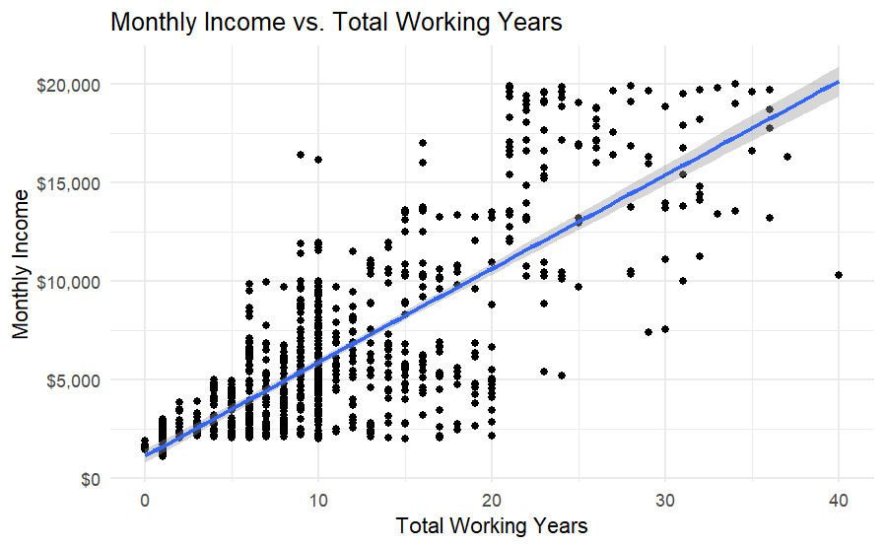
Monthly Income
Notes:
Top 2 correlation with monthly income were job level and total working years. As shown on scatter plots here,
As the job level increase, so as the median monthly income.
And as total working years increases, so as the median monthly income.
Since salary range for each job level are defined by the company, it is obvious that it is highly related to monthly income and we can predict someone’s monthly income from it. Work experience is a common factor that affect how much an employee got paid, and that work experience reflected on the total working years.

Slide 10
Monthly Income Models
Approach:
Linear Regression
Leave-one-out cross validation
Criteria: attain RMSE (Root Mean Squared Error) below 3,000
Models’ variables:
Model 1: JobLevel
Model 2: TotalWorkingYears
Model 3: JobLevel + TotalWorkingYears
Model 4: JobLevel + TotalWorkingYears + (JobLevel) * (TotalWorkingYears)
Model | R-Square | RMSE
Model 1 | 0.9052 | 1,415
Model 2 | 0.6037 | 2,893
Model 3 | 0.9081 | 1,393
Model 4 | 0.9165 | 1,328
Model 4 was used to predict a new dataset of 300 observations (employees)
Notes:
We used linear regression approach to create model for monthly income prediction. The criteria for the model is to have Root Mean Squared Error less than 3000.
Four different models were compared, using joblevel and totalworking years alone and two together, lastly add an interactive term, the product of joblevel and totalworking years for Model 4.
Model 4 has the least Root Mean Squared Error and also below 3000. It was chosen for monthly income prediction.

Slide 11
Summary
The top three contributing factors to employee attrition are:
Job Level/Monthly Income
Overtime
Job Involvement
The top influential factors in employee attrition are:
Stock Option Level
Age/Generation
Marital Status
Total Working Years
Job Roles
Job roles with median monthly income lower than the company’s median (~$5,000) had a relatively higher attrition rate.
Manufacturing Director had much lower attrition rate comparing to other job roles that had similar median monthly income. Potential to study the area and apply any lesson learned to other job roles to increase retention.
Notes:
In summary,
employees who are relatively younger, just started or at the beginning of their career, are single, at stock option level 0 or those who do not own any company stock, those who work overtime, have low job involvement, would be more likely to leave the company.

Slide 12
Thank you!
Katon Pang
katonp@smu.edu
Notes:
Thank you. We appreciate your time with us. Please feel free to contact me if there’s any questions.

